Slide 1
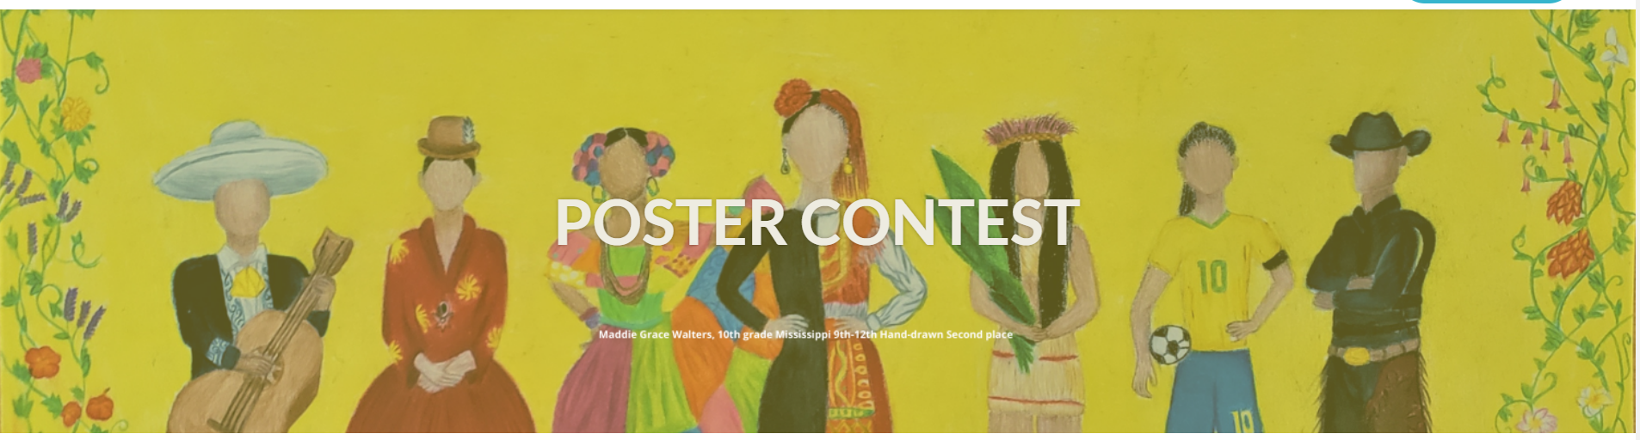
AATSP Brazos Chapter 2023

Slide 2
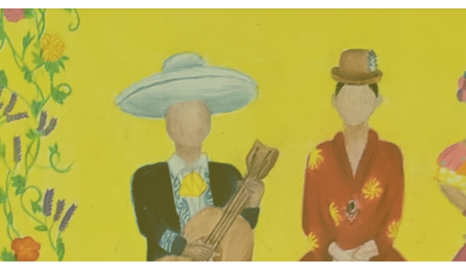
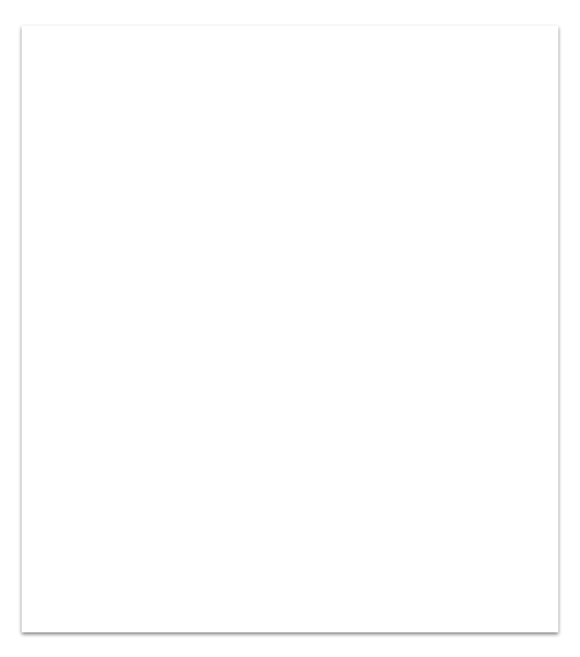
Tertulia Monday, February 20th at 6 pm
purpose
go over the guidelines, suggest strategies and resources, including ideas from an art teacher, and answer any questions you may have.
note
presentation will be available afterwards on our website

Slide 3
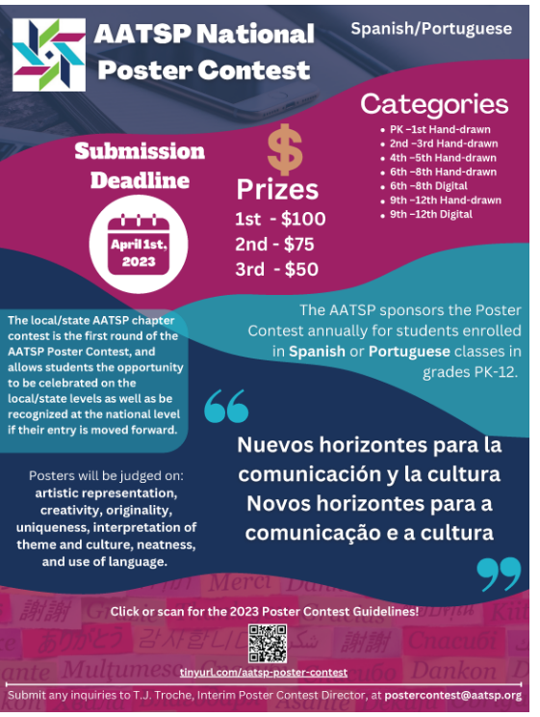

Slide 4

Promote creative thinking and celebrate visual learners and artistic expression!

Slide 5
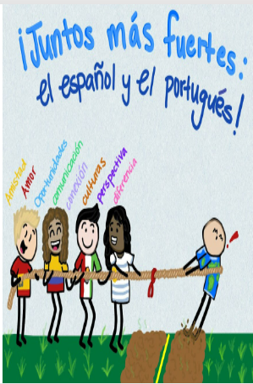
1. Intro
AATSP BRAZOS Chapter invites you to get your artistic students recognized!
Do a creative assignment with your students before Spring Break to express how they interpret the theme “Nuevos horizontes para la comunicación y la cultura “ either with a handmade or digital poster.
Select your three best hand drawn (any grade PK- 12), and three best digital (grades 6-12) interpretations
Take high resolution pictures of each poster, saved in .JPEG or .png format .
Submit your entries to the Brazos chapter Contest Coordinator by 5 pm March 15, 2023. Be sure to include a Student Release form for each entry. Collaborative entries (2 students making one poster) are welcome; just be sure to send a release form from each student.

Slide 6
Guidelines
Brazos Chapter Poster Contest will follow the guidelines for the National Contest
The theme MUST be written on the poster.
All language must be in Spanish (or Portuguese).
No copyrighted images are allowed.

Slide 7
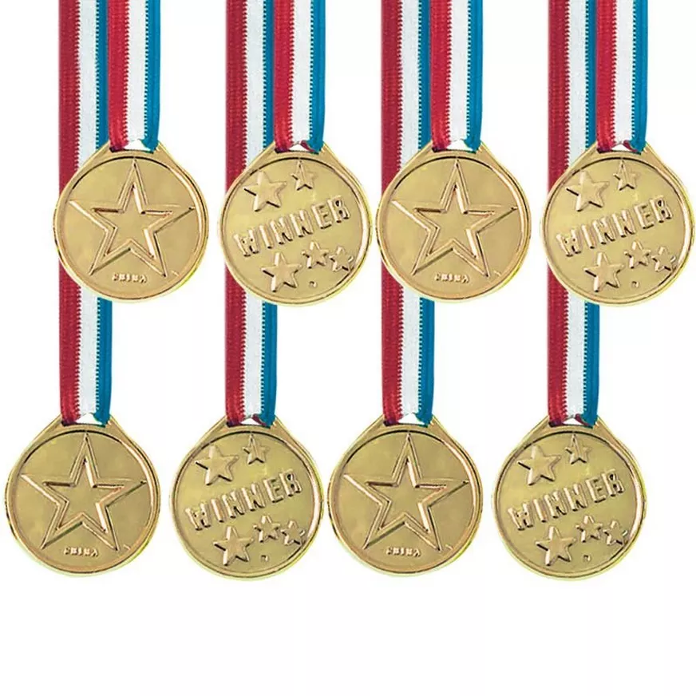
Categories:
• Grades PK–1st Hand-drawn
• Grades 2nd–3rd Hand-drawn
• Grades 4th–5thHand-drawn
• Grades 6th–8th Hand-drawn
• Grades 6th–8th Digital
• Grades 9th–12th Hand-drawn
• Grades 9th–12th Digital

Slide 8
Chapter winners will be announced March 30
National winners will be announced around May 1st.
National Winning posters will be displayed on the AATSP
website, showcased at the AATSP Annual Conference in Salamanca, Spain in June, and reprinted as necessary

Slide 9
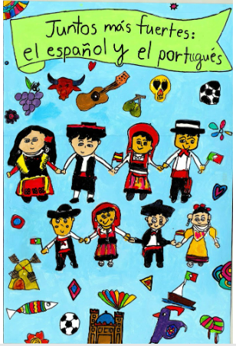
Prizes for 1st, 2nd, and 3rd place Chapter winners for each category
Special recognition for you as their teacher!
Winners will be submitted to the National AATSP Poster Contest, and may win national prizes as well!

Slide 10
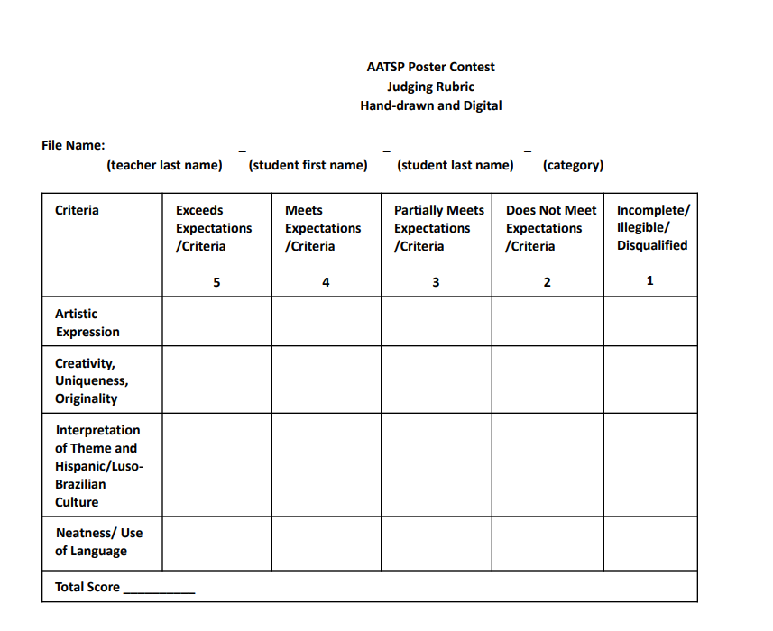

Slide 11
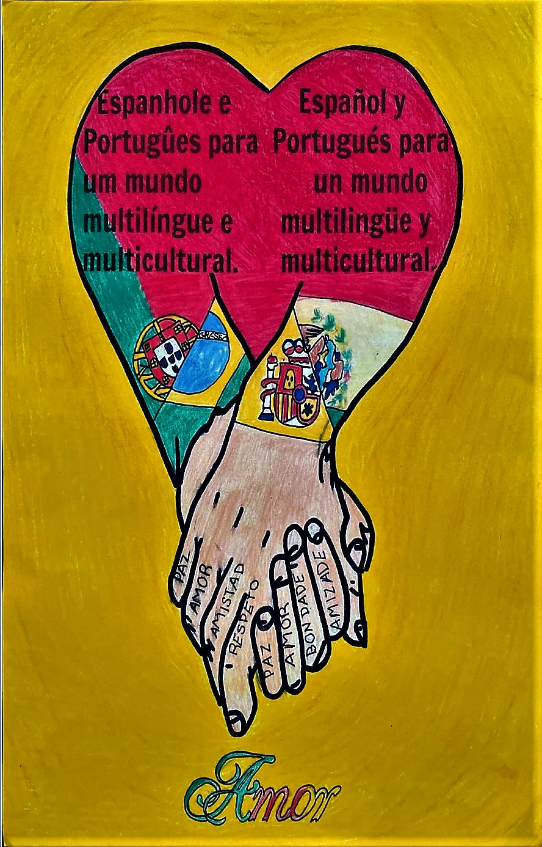
Judging Criteria:
Posters will be judged on:
- artistic representation
- creativity
- originality
- uniqueness
- interpretation of the theme and culture
- neatness
- use of Spanish or Portuguese language

Slide 12
AATSP Poster Contest Judging Criteria
1. Artistic Expression: Are the elements within the poster used to convey a message, an emotion, a purely aesthetic experience, or a combination of the three?
2. Creativity, Uniqueness, Originality: Did the student take an innovative approach in portraying the subject matter or visual material? Is it creative and original (i.e. no use of material from previous posters, or copyrighted/trademarked images/characters [these are grounds for immediate disqualification])?
3. Interpretation of Theme and Hispanic/Luso-Brazilian Culture: Does the poster reflect the theme? Is Hispanic/Luso-Brazilian culture prominently and appropriately represented?
4. Neatness/Use of Language: Does the poster show attention to details which enhance the overall effect or carry out the basic theme or design? Is the poster visually appealing as a whole? Is all the language used on the poster in Spanish or Portuguese and accurate in terms of spelling/grammar/accentuation?

Slide 13
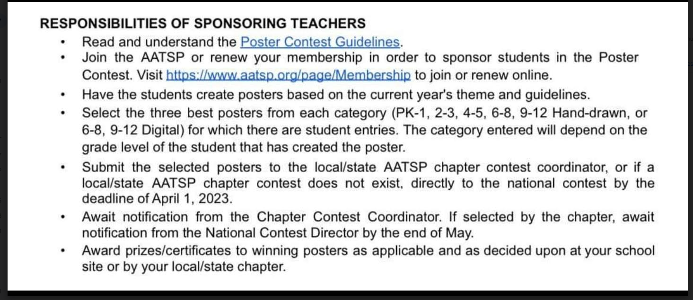

Slide 14
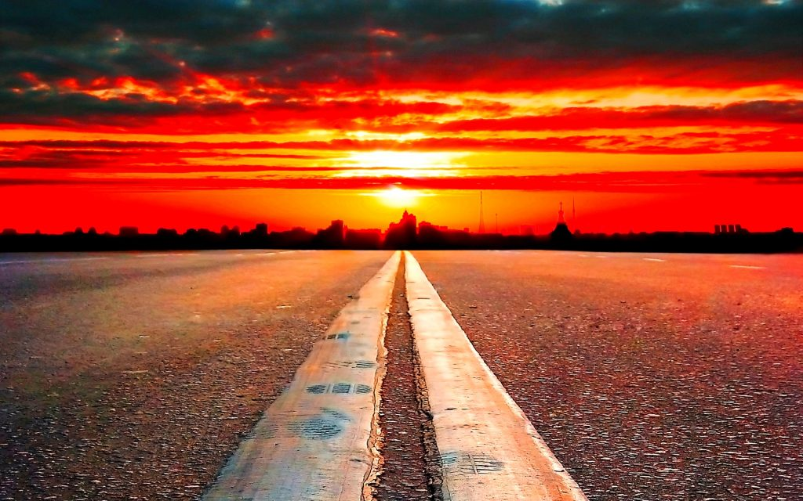
Theme: Nuevos Horizontes para la Comunicación y la Cultura.
Deadline: March 15, 2023

Slide 15
Helpful tips to making a Poster
Fostering Creativity
Define what Horizons means to you.
Visualize and Feel what the Theme means
A Great tool is a MIND MAP

Slide 16
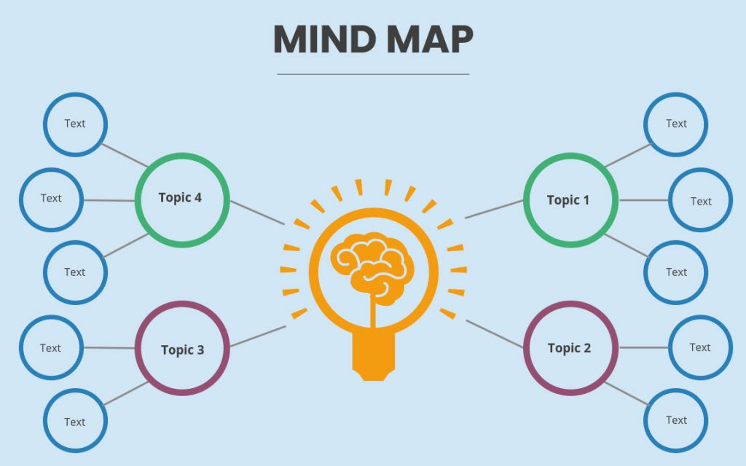
Put all ideas on a map and then begin the illustrations.

Slide 17
Top tools to create a Digital Poster
Tools Adobe Spark
Adobe Creative Cloud
Canva
Piktoart
These tools let you put it together
from images

Slide 18
Drawing Tools to making a Digital Poster
These tools let students draw:
Clip Studio Paint
Gimp
Krita
Artweaver Free
Sketchpad
Astropad Studio
Adobe Illustrator
Inkscape
Vectr
Adobe Photoshop

Slide 19
Helpful tips to making a Digital Poster
Tip 1 Try free versions
Tip 2 Go with what your school provides
Tip 3 Many students already have programs in their personal computers
Quotes for illustration purposes only

Slide 20
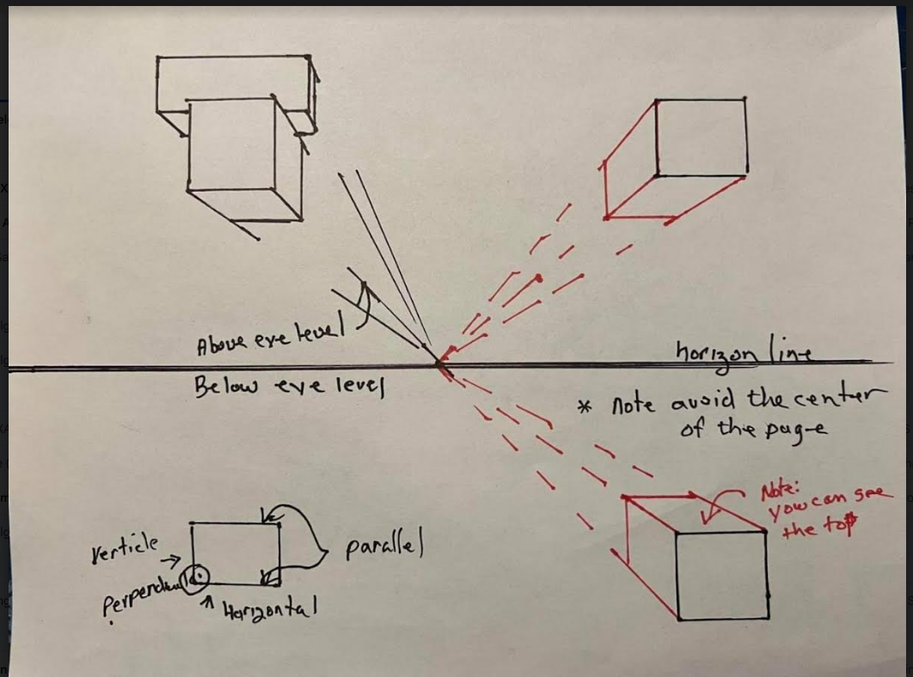

Slide 21
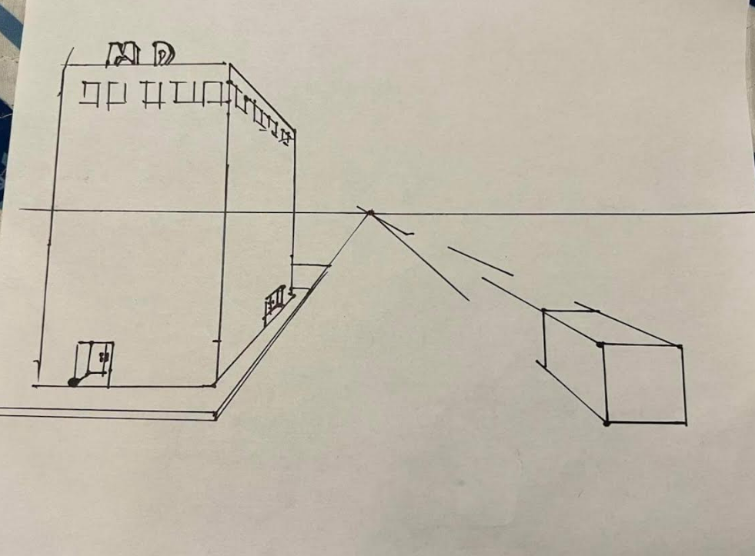

Slide 22
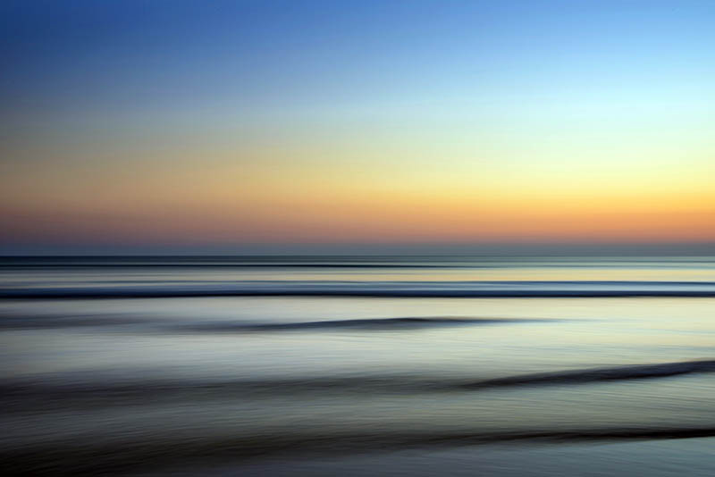
¡Gracias por ayudarnos a reconocer el talento artístico de sus estudiantes y por su participación!
Please send up to 3 entries per category to Submission Form Brazos
Send a consent signed form for each student. Student Release Form
If you have any questions contact Cheryl Fuentes Brazos Chapter Contest Coordinator
cherylfuentesw@yahoo.com

